Slide 1
Computer Vision
Talk presented by
Ian Gonzalez-Alfonzo and Lucas Bell-Steckel

Slide 2
What is CV?

Slide 3
Definition
According to the encyclopedia Britannica, computer vision is a,
“Field of artificial intelligence in which programs attempt to identify objects represented in digitized images provided by cameras, thus enabling computers to ‘see.’”

Slide 4
Branches
Object Detection
Object Tracking
Facial Recognition
Image Filters
Resolution Scaling
Image Generation
Generating Image Description
Object Selection within photos

Slide 5
Fundamentals of Computer Vision

Slide 6
What Is Image Processing?
Image processing is the use of algorithms and mathematical models to process and analyze digital images.
An image can be defined by a two-dimensional array specifically arranged in rows and columns, so a number of different techniques can be applied to them.

Slide 7
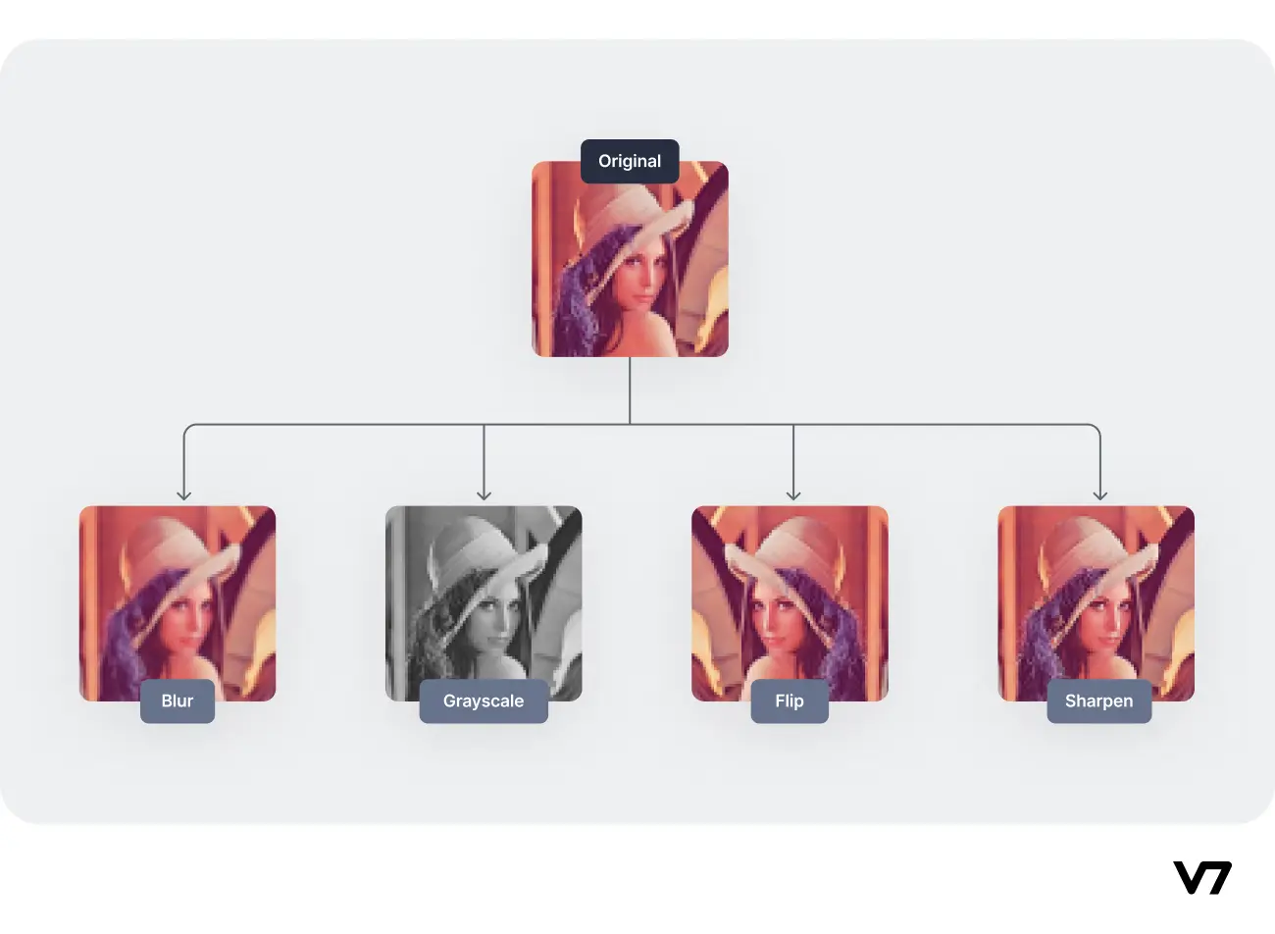
Image Processing Techniques

Slide 8
Feature Extraction
Features are parts or patterns of an object in an image that help to identify it.
Features include properties like points, corners, edges, regions of interest, etc.
Feature extraction is the process of identifying and extracting relevant features from raw data.

Slide 9
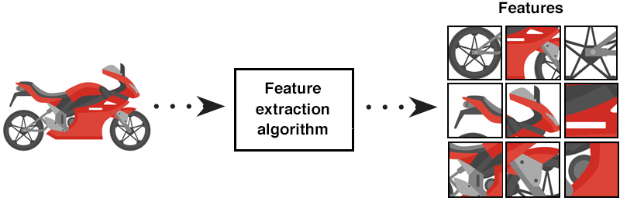
Feature Extraction

Slide 10
Object Detection
Object detection is the task of locating objects of interest within visual data.
Subtasks:
Localization: outputting the spatial extent of detected objects within the image, with bounding boxes, for example
Classification: classify each detected object into predefined classes.
Applications:
Autonomous driving
Surveillance and security systems
Robotics
Medical imaging
And many more!

Slide 11
Object Detection

Slide 12
CV and Deep Learning

Slide 13
What is Deep Learning?
The subset of machine learning based on artificial neural networks
Teaches computers to process data in ways similar to the human brain
Can recognize complex patterns in pictures, text, sounds, and other data to produce accurate predictions
At the heart of the recent advances in AI and of much research in Computer Science and even other fields!

Slide 14
How is it Useful in CV?
In recent years, much computer vision work has shifted from traditional, rule-based methods to deep learning as a more adaptable method than these traditional methods.
Traditional methods are limiting in intricate scenarios.
As deep learning learns from data, it can be more versatile at identifying complex patterns.

Slide 15
CNN's
Deep Learning algorithm that learns features in an image via filters/kernels.
Designed for processing grid-like data, like images.
Convolution operation: each element of the kernel is multiplied with the corresponding element in the input data, and then the results are summed up. This process is applied across the entire input data to produce a feature map.
The convolution operation helps capture local patterns and spatial relationships within the input data better than other deep learning models, such as fully-connected networks.

Slide 16
Kernels (or Filters)

Slide 17
Details
Input Layer
Convolutional Layer
Activation Functions
Pooling Layer
Dropout Layers
Flattening Layer
Fully Connected Layer
Output Layer
model.compile() inputs
Other Details

Slide 18
Input Layer
Receives the raw input data, such as images or sequences of text.
Each node in the input layer corresponds to a feature or pixel in the input data.
Provides the initial representation of the data for further processing by subsequent layers.

Slide 19
Convolutional Layer
Applies learnable filters to the input data, capturing spatial hierarchies of features.
The filters slide over the input data, performing element-wise multiplication and summation.
Specializes in detecting specific features or patterns through the learned filters.

Slide 20
Activation Functions
Nonlinearity Introduction: Activation functions introduce nonlinearity to neural networks, allowing them to learn complex patterns and relationships in data that linear functions cannot capture.
Output Transformation: Activation functions process the weighted sum of inputs and biases at each neuron, transforming the result into an output that represents the neuron's activation state.
Gradient Propagation: play a crucial role in backpropagation, enabling the efficient propagation of gradients during the training process, which is essential for adjusting model parameters and minimizing the loss function.

Slide 21
Activation Functions
Sigmoid: Squashes input values between 0 and 1, suitable for models requiring probabilities as outputs.
ReLU (Rectified Linear Unit): Sets negative values to zero, promoting sparse activation and faster training of deep neural networks.
Linear (Identity): Outputs input values without any transformation, commonly used in regression tasks for predicting continuous values.

Slide 22
Pooling Layer
Reduces the spatial dimensions (width and height) of the feature maps while retaining important information.
Common techniques include max pooling and average pooling.
Helps make the representation invariant to small translations, distortions, and variations in the input data.

Slide 23
Dropout Layer
Regularization technique used to prevent overfitting by randomly setting a fraction of input units to zero.
Has the effect of making the training process noisy, forcing nodes within a layer to probabilistically take on more or less responsibility for the inputs.

Slide 24
Flattening Layer
After the last convolutional and dropout layers, the Flatten layer reshapes the 2D feature maps into a 1D vector. This prepares the data for the fully connected layers.

Slide 25
Fully Connected Layer
Connects every neuron in one layer to every neuron in the next layer.
Combines high-level features learned from previous layers to make final predictions.
Often used in classification tasks to generate class scores or probabilities.

Slide 26
Output Layer
Produces the final predictions or classifications based on the features learned by previous layers.
The number of neurons in this layer depends on the task (e.g., number of classes in classification tasks).
Typically includes an activation function (e.g., softmax) to generate class probabilities.
The softmax function normalizes the raw output scores of the network into a probability distribution, where each output value represents the probability of belonging to a particular class. In other words, it ensures that the output values are between 0 and 1.

Slide 27
model.compile() inputs
Loss function: method of evaluating how well your ML algorithm models the dataset.
Example: Categorical cross-entropy (common for multi-class classification problems)
Optimizer: responsible for updating the weights of a neural network during training
Example: Adam offers adaptive learning rates, momentum, and robustness to noisy and sparse gradients, making it efficient and effective for training deep neural networks compared to other optimizers.
Metrics: metrics to be evaluated during training and testing.
Example: Accuracy = Correct predictions / All predictions

Slide 28
Other Details
Epochs: Represent one complete pass through the entire training dataset during the training of a machine learning model.
Batch size: Dictates the number of samples processed before updating the model's parameters. Smaller batches enable more frequent updates, potentially hastening convergence, but may introduce noise and slow training. Conversely, larger batches offer more stable updates but demand greater memory and computational resources.

Slide 29
Other Details
Training Set: Used to train the model by adjusting parameters to minimize the error between predicted and actual outcomes.
Validation Set: Utilized to tune hyperparameters and prevent overfitting by evaluating the model's performance on independent data during training.
Test Set: Assesses the final performance of the trained model on unseen data, providing an unbiased estimate of real-world performance before deployment.

Slide 30
Example CNN: VGG16
VGG16 is object detection and classification algorithm which is able to classify 1000 images of 1000 different categories with 92.7% accuracy. It is one of the popular algorithms for image classification and is easy to use with transfer learning.

Slide 31
VGG-16 CNN Architecture
CNN architectures contain an upstream feature extractor followed by a downstream classifier.
The feature extractor contains five convolutional blocks that constitute the model's feature extraction segment.
Convolutional blocks consist of one or more convolutional layers followed by a pooling layer.
The feature extractor is followed by the classifier, which transforms the extracted features into class predictions in the final output layer.

Slide 32
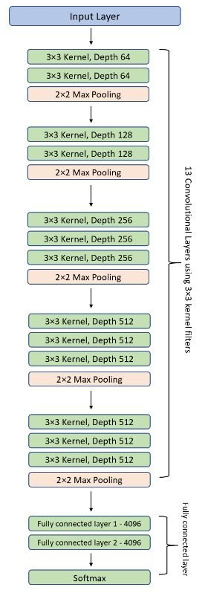
CNN Architecture

Slide 33
Future of CV

Slide 34

Recent Innovations
Some researchers are integrating LLM’s with computer vision. One such example of this is ViperGPT, which is a LLM that is capable of applying logic and reasoning for a query with an input image.
ViperGPT: Visual Inference via Python Execution for Reasoning (columbia.edu)

Slide 35
Possible Future Developments
Increased development in AR and VR could stimulate more developments in computer vision in the 3D space, not just the 2D space
Wider industry adoption of autonomous driving capabilities
Growing emphasis on privacy: for example, face blurring in public camera recordings
Greater role in countering misinformation, such as in deepfake detection

Slide 36
References
Boesch, Gaudenz. “VGG Very Deep Convolutional Networks (Vggnet) - What You Need to Know.” Viso.Ai, 11 Feb. 2024, viso.ai/deep-learning/vgg-very-deep-convolutional-networks/.
“The Future of Computer Vision.” NVIDIA Technical Blog, 14 Mar. 2023, developer.nvidia.com/blog/the-future-of-computer-vision/.
GfG. “Digital Image Processing Basics.” GeeksforGeeks, GeeksforGeeks, 22 Feb. 2023, www.geeksforgeeks.org/digital-image-processing-basics/.
“How to Know If Your Machine Learning Model Has Good Performance: Obviously Ai.” Data Science without Code, www.obviously.ai/post/machine-learning-model-performance. Accessed 1 Mar. 2024.
“Image Processing: Techniques, Types, & Applications [2023].” V7, www.v7labs.com/blog/image-processing-guide. Accessed 1 Mar. 2024.
“ViperGPT: Visual Inference via Python Execution for Reasoning.” ViperGPT: Visual Inference via Python Execution for Reasoning, viper.cs.columbia.edu/. Accessed 2 Mar. 2024.
Ghosh, Ankan. “Moving Object Detection Using Opencv.” LearnOpenCV, 13 Jan. 2024, learnopencv.com/moving-object-detection-with-opencv/.

